Slide 1
TICKET RESERVATION ON IRCTC
By
b. Sai sujay
192011311

Slide 2
Objective
Testing helps in evaluating and accessing the features of website application so that it works accurately.

Slide 3
Abstract
Testing is an important part of every software development process on which companies devote considerable time and effort.
To automate the IRCTC which is designed keeping in mind to make it one of the best automation system for keeping all the tracks of the details of their customers
The e-booking business is increasing very rapidly. So it is very important to test e-boking websites and applications such as IRCTC.
Testing process which include in this automation are :
1. functionality checking
2. test scenarios

Slide 4
Proposed system
Installation of the software to automate the Ticket reservation system-
-android studio-visualization
-visual studio cade-to write code
- Appium- To automate the application
First login to the Ticket reservation system website or the application
Sign up with your email or the phone number
Create your username and password
Then search for options
Enter the pin
search for the trains
Book the ticket
payment

Slide 5
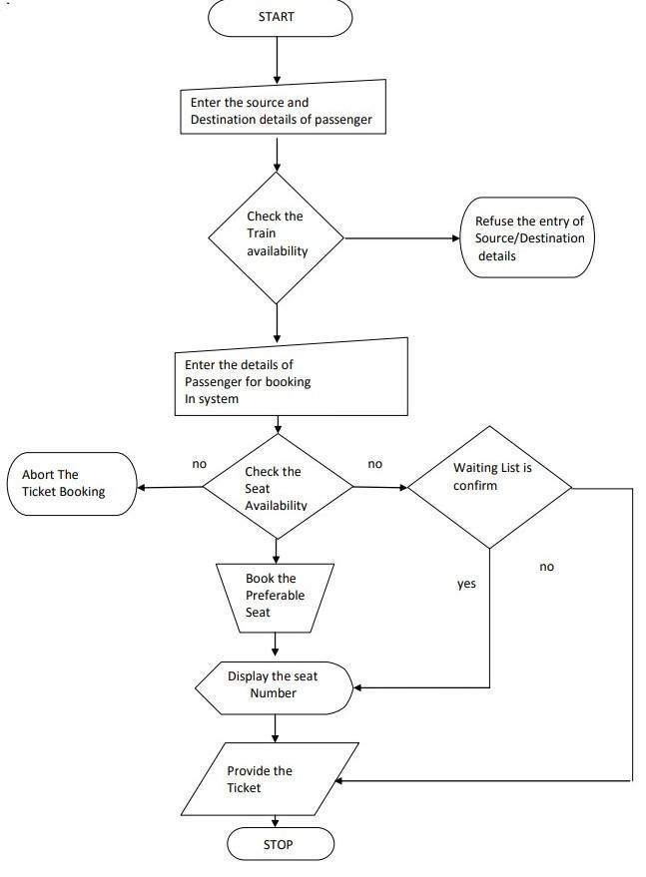
Flowchart

Slide 6
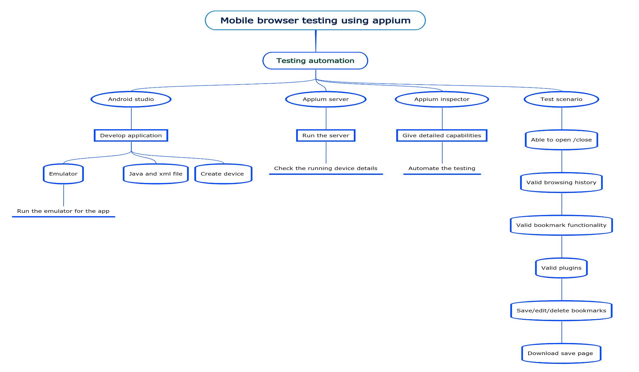
Concept map

Slide 7
Test cases
log in id
verify the password
status of availability seats
Available seats of train
Payment details
Details of the customer
Booking history
Checking id proofs
Cancellation option
Refunded money option
Download the ticket the option

Slide 8

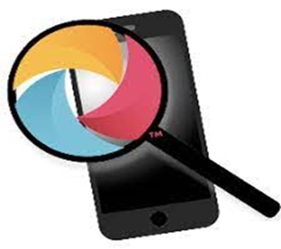

Apps tools and installation
Appium Server
Appium Inspector
Android Studio

Slide 9
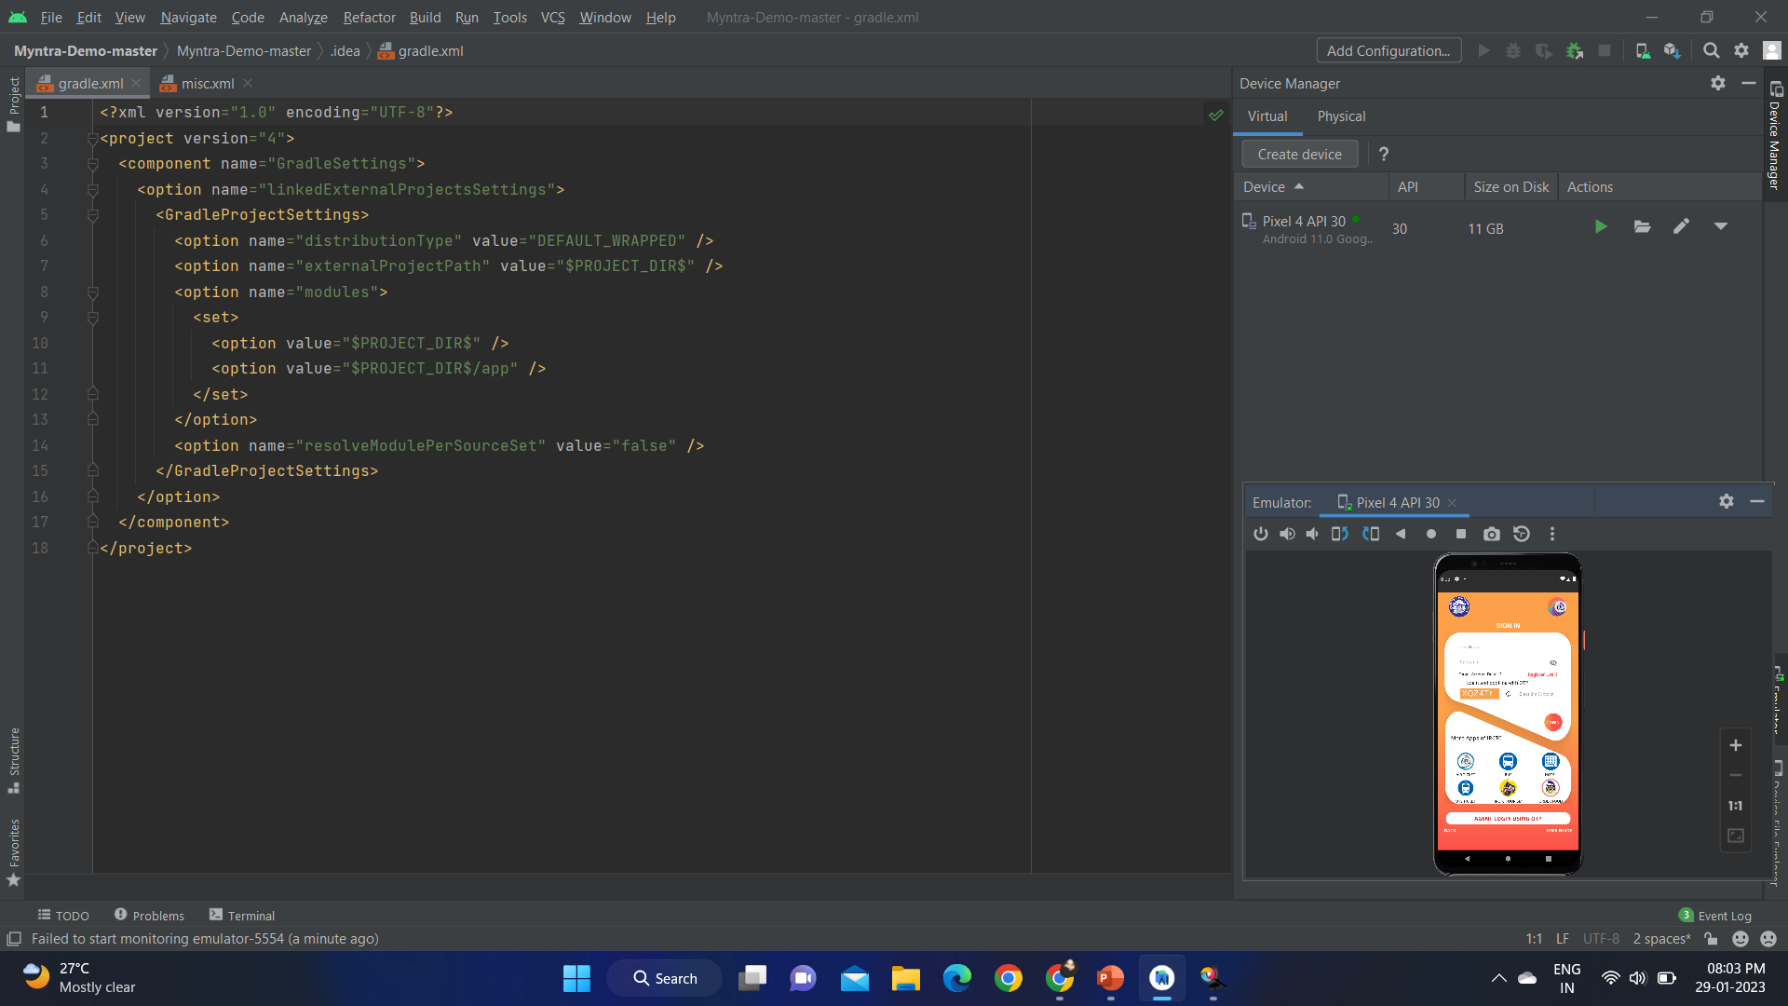
IMPLEMENTATION

Slide 10
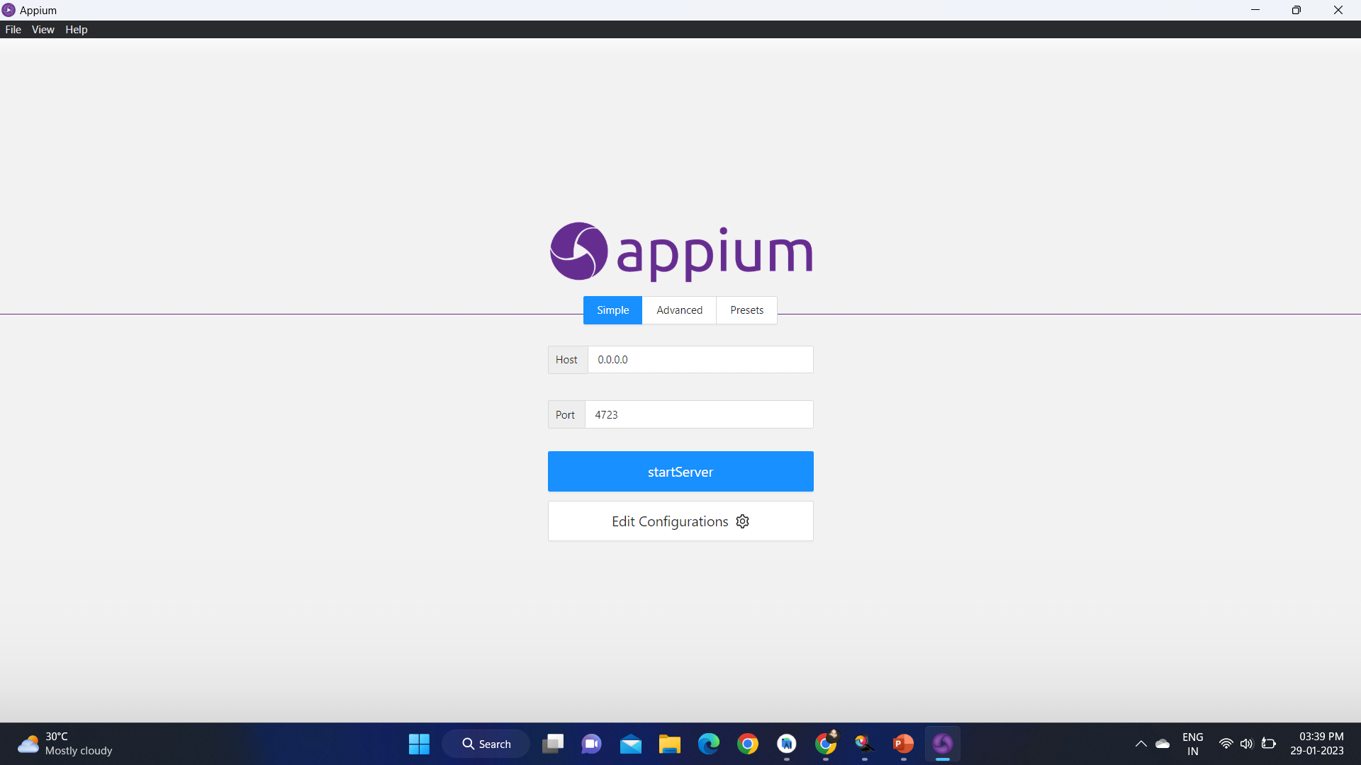

Slide 11
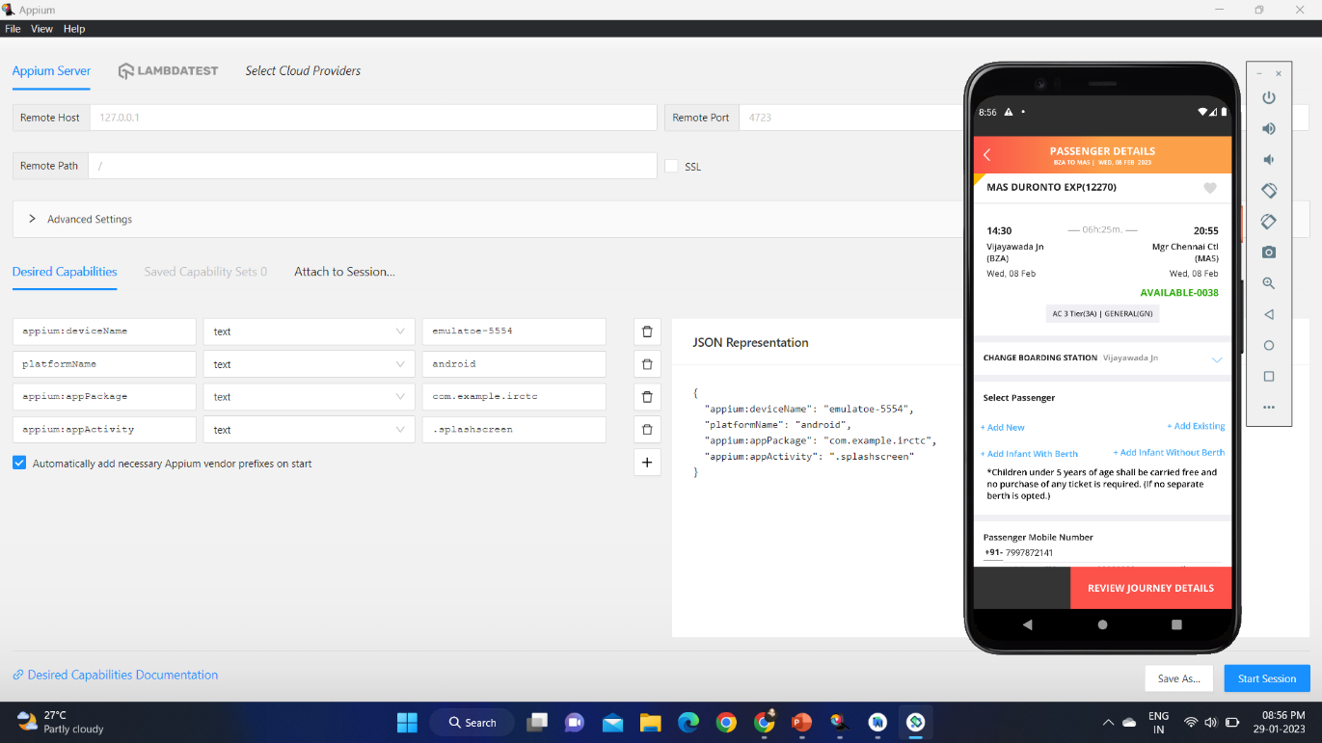
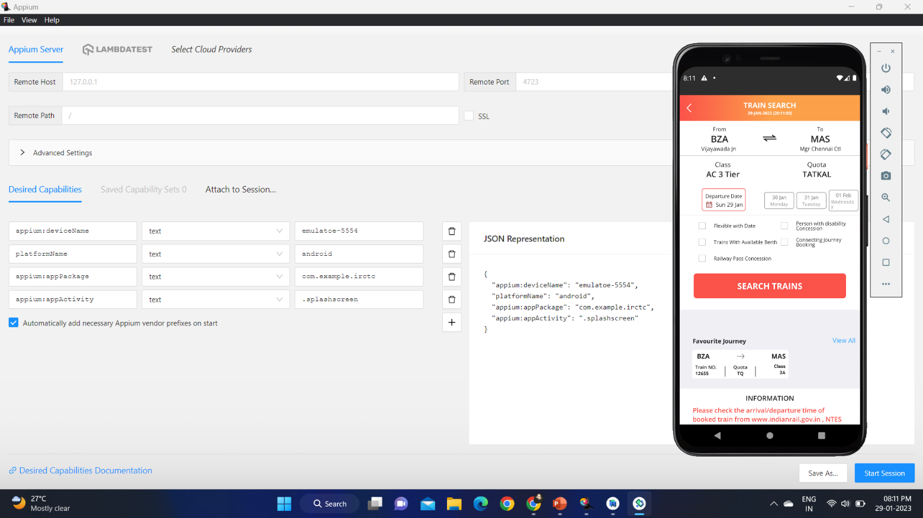

Slide 12
Test cases
Test case | Type- negative/positive
Verify the ticket booking website is loading properly or not | positive
Verify the search results have wrong | negative
Verify the user can see the available seats | positive
Verify the user cannot see the available seats | negative
Verify the seat is booked | positive
Verify the seat is not booked | negative
verify the user should receive the sms or mail after successfully booking of ticket | positive
Verify the user cannot receive the sms or mail after successfully booking of ticket | negative
Verify the user cancel the ticket then his amount should get refunded | positive
Verify when user tries to cancel the ticket on the day of travelling then he should not get full amount as refunded | negative

Slide 13
conclusion
we navigate the ticket reservation web application and find out the positive/pass and negative/fail test cases. This is to improve the application performance in better manner

Slide 14

THANK YOU

